Slide 1

COMMUNICATIONS DEPARTMENT: PROTOCOL
Boyan Naydenov, Josep Puig, Josep Maria Serra, Sergi Tarroc and Eva María Urbano

Slide 2

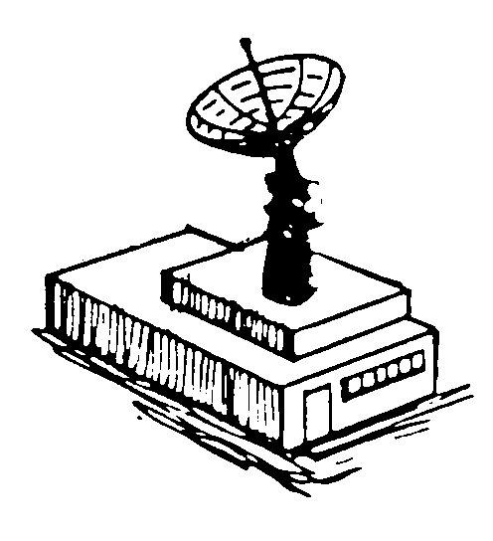
What are we going to talk about?
Work done: Protocol
Space segment
Ground segment
Work to do: Ground Station
Exploration avenues

Slide 3

Space segment: Consultive Committee for Space Data Systems (CCSDS)
Objective of CCSDS: Enhance governmental and commercial interoperability and cross-support while reducing risks during communications.
CCSDS recommendations are routinely submitted to the International Organization for Standardization (ISO).
Using CCSDS standards it is assured that communication between satellites of Astrea constellation and satellites of the clients is possible.

Slide 4
The space communications protocols are defined for the five layers of the ISO model.
Layer | Name | Function
5 | Application | Network process to application, data presentation
4 | Transport | End-to-end connections and reliability
3 | Network | Path determination
2 | Data Link | Node-to-node data transfer
1 | Physical | Electrical and physical specifications of the data connection

Slide 5
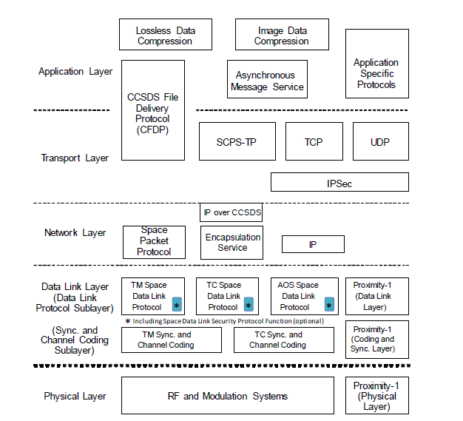
Space communications protocols

Slide 6
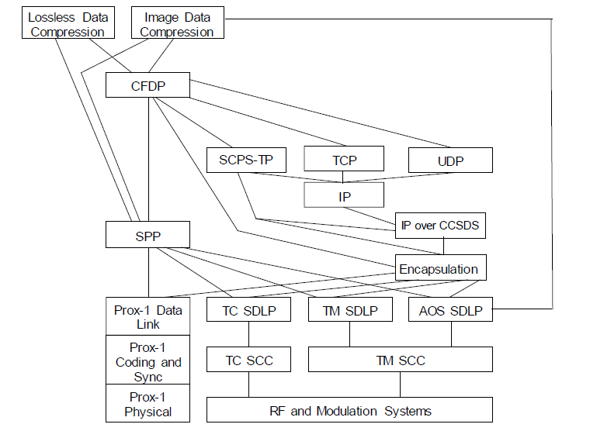
Some possible combinations
for space communications
protocols

Slide 7
Transport Layer
User Datagram Protocol (UDP) | Stream Control Transmission Protocol (SCTP) | Transmission Control Protocol (TCP)
Conectionless Unreliable Performs very limited error checking | Reliable Message-oriented Designed for Internet applications | Connection-oriented Flow and error control mechanisms Extension to adapt the protocol to space needs (SCPS-TP)
Protocol to be used in the Transport Layer: SCPS-TP

Slide 8
Network Layer: Main protocol
Space Packet Protocol (SPP) | Internet Protocol version 4 (IPv4) | Internet Protocol version 6 (IPv6)
Work easily with the protocols of the adjacent layers. Requires Path ID: In Astrea constellation there are 39800 possibe routes. Path ID parameter: 11 bit. 2048 routes. | Needs IP over CCSDS and Encapsulation Service. Instead of Path ID uses IP adress of the source and destination node. Shorter header. More additional protocols than IPv6. | Needs IP over CCSDS and Encapsulation Service. Instead of Path ID uses IP adress of the source and destination node. Larger header. Less processing than IPv4 Progressively replacing IPv4
Main protocol of the Network Layer: IPv6

Slide 9
Network Layer: Routing protocol
Enhanced Interior Gateway Routing Protocol (EIGRP) | Open Shortest Path First (OSPF) | Routing Information Protocol (RIP)
Compatible with IPv6 Topology changes, not the whole routing table: less data transmitted. Authentication processes | Compatible with IPv6 Each router exchanges its adjacency links with adjacent routers Each router creates its own routing table Transmit only the adjacencies. | More time to converge Poor scalability Easier to configure
Routing protocol: Select routes between two nodes of the network
2000 entries to update frequently
205 entries to update frequently
39800 different entries in the routing table (only satellite nodes)

Slide 10
Network Layer: Complementary protocols
IP over CCSDS and Encapsulation Service
ICMPv6: Expands features of IPv6

Slide 11
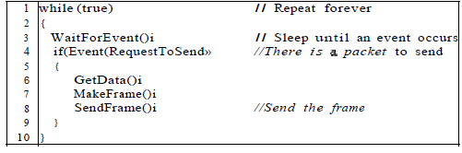
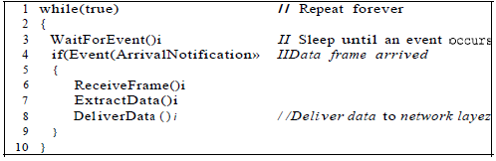
Data Link Layer: Working procedure
Simplest Protocol: No error. No flow control.
Sender’s algorithm
Receiver’s algorithm

Slide 12
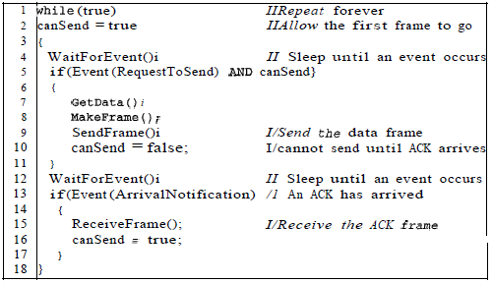
Data Link Layer: Working procedure
Stop-and-Wait Protocol: Feedback included
Sender’s algorithm

Slide 13
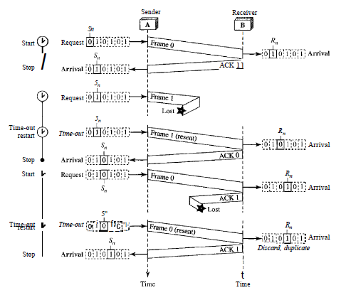
Data Link Layer: Working procedure
Stop-and-Wait Automatic Repeat Request
Flow diagram

Slide 14
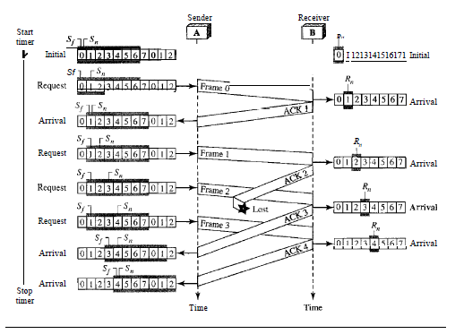
Data Link Layer: Working procedure
Go-Back-N ARQ
Flow diagram

Slide 15
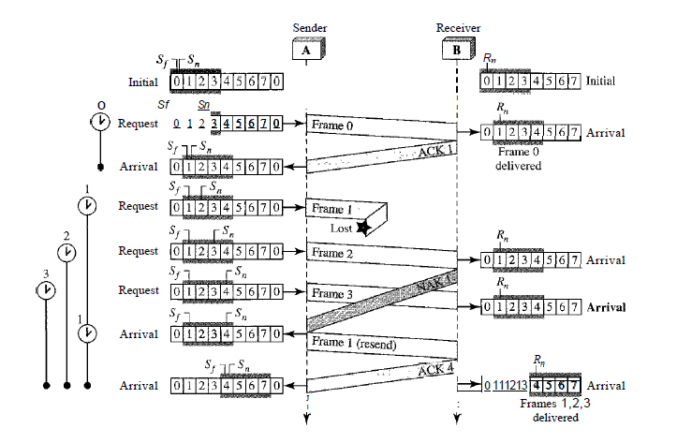
Data Link Layer: Working procedure
Selective Repeat ARQ
Flow diagram

Slide 16
CCSDS DLL: Data Link Protocol Sublayer
TM Space Data Link Protocol | TC Space Data Link Protocol | AOS Space Data Link Protocol | Proximity-1 Space Link Protocol-Data Link Layer
- Stop-and-Wait | Type A: Go-Back-N ARQ Type B: Stop-and-Wait Protocol | - Stop-and-Wait | - Go-Back-N ARQ
TC Space Data Link Protocol is the chosen one because:
Inserts security into a frame using the Space Data Link Security (SDLS)
Allows more streams of bits in a single physical channel using VC

Slide 17
CCSDS DLL: Synchronization and Channel Coding Sublayer
Makes a stream of bits that can be transfered by the antenna out of the data provided by the above layers.
TC Space Data Link Protocol
TC Sync and Channel Coding

Slide 18
Ground segment:
How will the data be presented to the client? Application
Protocols
File Transfer Protocol (FTP) | Secure Shell (SSH)
To transfer computer files between a client and a server Encryption Secured using SSL/TLS Protocols Slow | Cryptographic network protocol To operate securely over an unsecured network. Creates a secure channel between the client and the server
SSH will be used

Slide 19
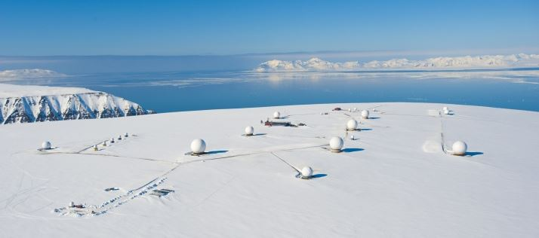
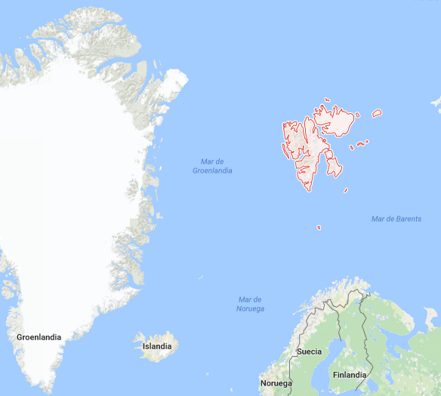
Ground station
Two open exploration avenues:
Existing GS that can be used
Legislation
Svalbard Satellite Station

Slide 20
Summary
Protocol
Space Segment
Transport Layer: SCPS-TP
Network Layer: IPv6, OSPF, IP over CCSDS, Encapsulation Service, ICMPv6
Data Link Layer: TC Space Data Link Protocol, TC Sync and Channel Coding and SDLS
Ground Segment
Application using SSH Protocol
Ground Station

